Slide 1

welcome
to
Kindergarten!
Baggett Elementary

Slide 2


Our Day
7:30 – 7:55 Morning Work/Restroom
7:55 Announcements Begin
8:00 Calendar
8:15 UFLI / Shared Reading
9:15 Reading DI
10:00 ELA
10:30 Lunch
11:00 Restroom
11:15-12:00 Specials
12:00-1:30 Math / Math NBI
1:30-1:45 Science/Snack/Pack up
1:50-2:05 Recess
2:15 Dismissal

Slide 3

Behavior
In our class we have the 5 simple rules:
1. Follow directions quickly
2. Always do your best
3. Be Kind to Others
4. Be a good listener
5. Keep our room safe
“Check your PAWS!”

Slide 4

Bear Bucks
Your Child’s Bear Bucks
· Every student will start the day with 5 Bear Bucks.
· Bear Bucks will only be taken after a verbal warning and if the misbehavior or lack of effort continues.
· Students can earn an extra Bear Buck each day for going above and beyond!
· Specials and support staff may remove a Bear Buck if necessary
Please initial your child’s binder every night and ask them how their day was! Thank you :)

Slide 5
PBIS
(Positive Behavior Interventions and support)
  The goal is to recognize everyone for making great choices throughout the day and allow them to be rewarded and praised for those choices.
  Throughout the day there will be many opportunities to be recognized for positive behavior. This can include: picking up trash in your area without being asked, sitting down and beginning your work without being prompted, helping a friend in need...etc
  Classes and students will earn rewards with their Bear Bucks earned!

Slide 6
Folder/ Notebook
  It must come to and from school with your child everyday.
  Please sign the behavior sheets nightly.
  Please check for important documents and/or reminders daily.
  Money needs to be in zipper pouches and NOT in a book bag or lunch box. Please label the money for whatever it is meant to be used for.
  Wednesday Folders: They will come home each week with all the work and any important papers. Please review them and return them Thursday morning.
  Any transportation changes must be handwritten and sent in their binder! (not in remind/talking points)

Slide 7

Handwriting
  In kindergarten we teach proper letter formation/handwriting. Students are expected to properly write all of the upper- and lower-case letters by the end of the year and adhere to the lines on paper.
  Practice handwriting at home as well!

Slide 8

Snack
  Please be sure to provide a hearty, healthy snack for your child (no candy or drinks other than water).
  We eat snack in the afternoon since we have an early lunch time.
  Examples of good snacks: Goldfish, crackers, fruit, graham crackers, etc.
  Please remember we cannot eat foods that require spoons or refrigeration.

Slide 9

Frozen Fridays and Hat Money
  Students can purchase ice cream treats for Frozen Fridays through Revtrak.
  Students can purchase extras through the lunch line including chips, cookies, and snacks) If you wish to limit what they can buy, you will need to provide a written note.
  Please do not place money in their pockets, lunch boxes, or bookbags. We will not look there for the money, and they might miss out.
  Your child can wear a hat for a 50-cent donation to Relay for Life on Fridays only.

Slide 10

Transportation
  The way that your child goes home is of utmost importance.
  While it is important that your child is aware of their transportation and can tell me how they are supposed to go home, we cannot just take their word on how they go home or any transportation change.
  Communicate in a written note if your child will go home differently than what they normally do. Please sign and date the note so that we know you sent it. We CANNOT accept tranportation changes on Remind, e-mail, or talking points.
  No changes can be made after 2pm

Slide 11
Newsletters
  We send a weekly newsletter on Friday for the following week that reviews the information your child will learn over the week.
  It will also tell the color of the week and when students will wear that color if they can!
  Please review the newsletter and look for valuable information such as important dates and exciting news ☺

Slide 12

Star Student
  Each week we will choose a Star Student based on the character traits for the month and recognize them as the special helper for the week.
  Your child will get to share about themselves and their picture with the class. We will make a poster in class and display it in the hallway as our
“Star Student.”

Slide 13
Parent Excuses/Tardies
  Tardies- Parents will need to come in with their ID EVERY time they enter the building. This includes check-ins/checkouts and tardies
  If your child misses a day of school, please send in either a parent note or doctor’s note to excuse their absence on the day that they return to school. Please send a note to let us know the circumstances of your child’s absence. Also, if is recommended that your child be fever and/or vomit free for at least 24 hours without medication before returning to school.
  We start our day right away, so please try to avoid being tardy as your child will miss valuable instruction time.

Slide 14

Practice Skills
(Homework)
Homework is not required in kindergarten. Instead, we suggest you read a book as a family each night and discuss the book.
Technology resources: There are many educational sites on the Paulding County student dashboard page. They may also log in to Clever and use several apps, such as Splash Learn etc. You can use these at home to further enrich your child’s learning.

Slide 15
How do we grade?
  Our report card is found in Parent Portal. Students will receive quarterly report cards each 9 weeks. Teachers will offer parent teacher conferences in October and March, but will continuously communicate and send home student work in Wednesday folders.
  If you do not have a parent portal account set up at this time, please e-mail: portal@Paulding.k12.ga.us
  We assess individually with an observational and hands on approach as well as written assessments.
  If you would like to preview the standards we will learn this year, please visit www.georgiastandards.org.

Slide 16
GKIDS
(Georgia Kindergarten Inventory of Developing Skills)
  GKIDS is a year-long, performance-based assessment aligned to the state mandated content standards.
  GKIDS is aligned to the state's mandated content standards in English Language Arts, Mathematics, Science, and Social Studies.
  ELA and MATH standards will be assessed using two to five performance levels for each element.
  Not Yet Demonstrated
  Emerging
  Developing
  Demonstrating the Standard
  Exceeding the Standard

Slide 17

Reading DI Groups
(Differentiated Instruction)
What is a Reading DI group?
  Small group instruction
  Based upon student’s needs
  Phonics, fluency, handwriting and comprehension based

Slide 18
Math Standards
  Know number names and the count sequence (1-100 by 1s and 10’s).
  Count to tell the number of objects.
  Understand addition as putting together and adding to and understand subtraction as taking apart and taking from.
  Work with numbers 11–19 to gain foundations for place value.
  Describe and compare measurable attributes.
  Classify objects and count the number of objects in categories.
  Identify and describe shapes.
  Analyze, compare, create, and compose shapes.

Slide 19
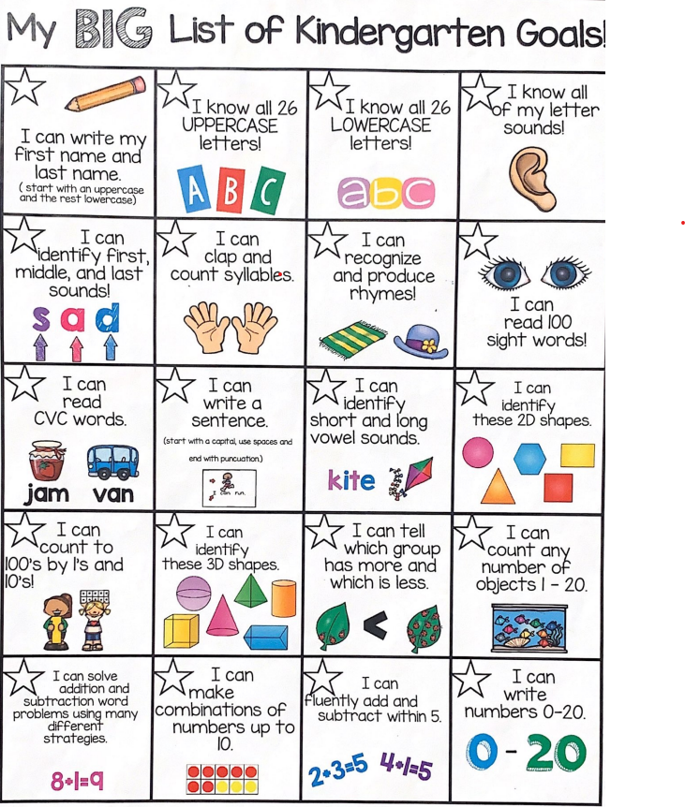
Kindergarten
End
Of
year goals

Slide 20
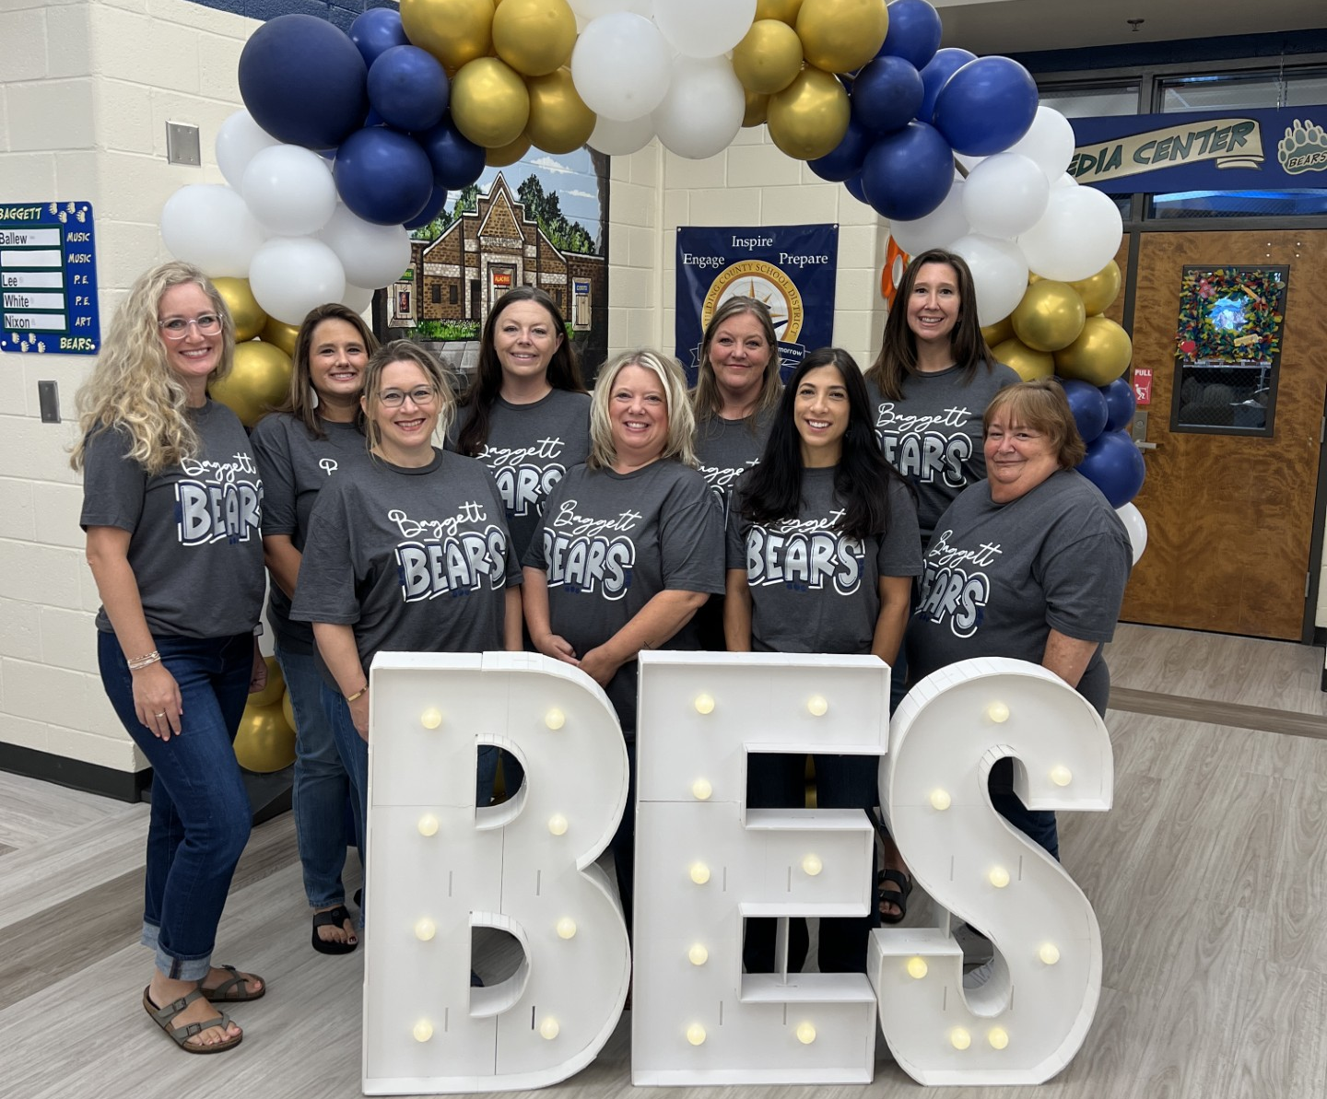

Questions
  Do you have any lingering questions? If so, please reach out to your child's teacher!
  Thank you for taking the time to learn all about kindergarten at Baggett! We look forward to an amazing year!

